Slide 1




Telecom Industry – Churn Rate Analysis
Using R ShinyApp

Slide 2



1
Team ROptimal
Telecom Churn Rate Analysis – R ShinyApp
Usama Ather
Kshama Sharma
Geetika Mittal

Slide 3





1
Project Map
Our approach to the problem
Telecom Churn Rate Analysis - Project Workflow
Business Problem –
understand reasons behind churn rate
Data & Methodology –
using R h2o and shiny packages
App Functionality–
developing interactive GUI for end business user
Analytics Problem –
using EDA and classification techniques
Model Building –
comparing different models for prediction
Project Objective
Develop Interactive Dashboard for Telecom Industry Business Professionals

Slide 4
1
How Can Our Dashboard Help?
Developing an interactive dashboard to solve a real-world business problem
Business Problem
Analytics Problem
ShinyApp
As per European Business Review, for top companies even a churn rate of less than 2% can lead to monthly losses of up to $65 million. Moreover, the cost of retaining is almost 50 times less than acquiring new customers.
Summarize the available information into actionable insights for the end user by deploying descriptive analytics in R
Use IBM sample dataset called Telecom Customer Churn to develop an interactive shinyapp dashboard
1
3
5
Also, as per Computer Weekly, telecom companies are spending a whopping 15-20% percent of their revenue on customer acquisition and retention.
Utilize the insights gathered to predict customer churn rate by designing it as a classification problem and using h2o API
Deploy machine learning models like Gradient Boosting, Deep Learning & Random Forests to predict customer churn rate
2
4
6
Source: European Business Review

Slide 5
1
Model Building
Gathering insights and predictions from data
Descriptive Analytics
Descriptive Analytics using ggplot
Using ggplot2 library for EDA to identify trends and insights from raw data
Rendering into shinyApp dashboard
Data Cleansing in R
Predictive Analytics
Deploying ML models to understand & predict customer churn rate
Deploying ML models in R using h2o API

Slide 6
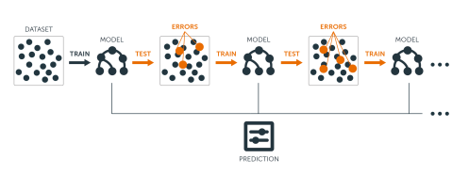
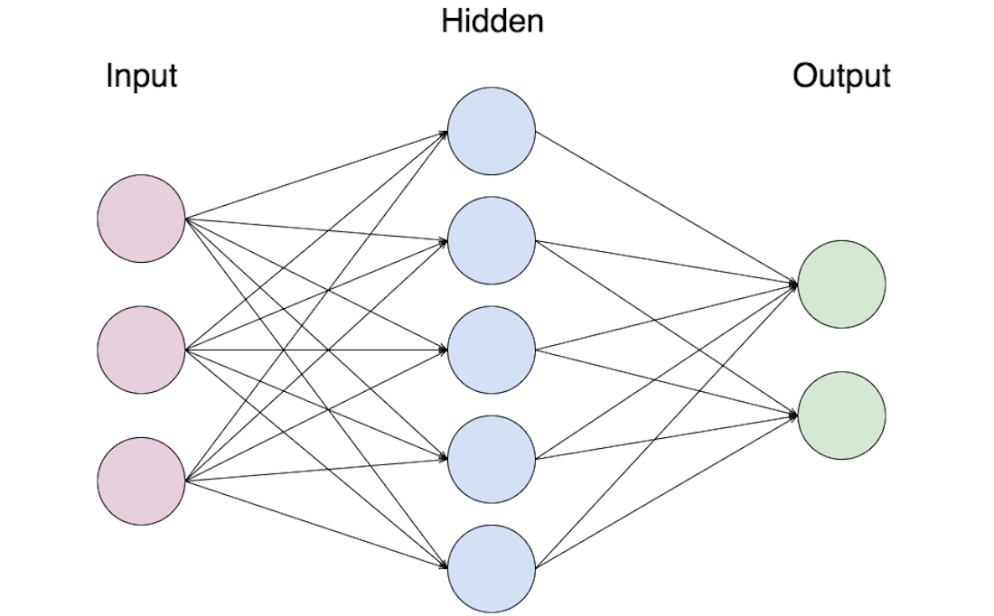

Model Results
Variable Importance
Model accuracy & variable importance
Contract
37.5%
Tenure
12.6%
Internet Service
11.0%
Monthly Charges
6.1%
AUC Score: .855
AUC Score: .852
AUC Score: .846

Slide 7
Thank You!

